Slide 1
ICT CyberSecurity Lesson 3:
Legal and Ethical Issues

Slide 2
Objectives: Lesson 3
5.3.1: Discuss issues related to downloading music or videos from the Internet, including unethical vs. illegal actions.
5.3.2: Compare and contrast rules for copyright and fair use, especially in relation to using online resources for school and educational purposes.

Slide 3
Copyright
The exclusive right to make copies, license, and otherwise exploit a literary, musical, or artistic work, whether printed, audio, video, etc.
Protected for the creator’s lifetime plus fifty years after his or her death
Copyrights may be renewed at the end of that time by the author’s estate

Slide 4
Original Works of Authorship
Text-based works
Computer programs
Musical compositions
Graphical creations
Sound recordings
Don’t have to register a copyright in order to have one
Any original work you create is automatically copyrighted

Slide 5
Copyright Infringement
An illegal use of copyrighted material
Downloading songs and movies without paying for them
Using pictures or content downloaded from the Internet without permission

Slide 6
Fair Use
The ability to use a copyrighted work's words, images, or ideas in a small, non-commercial way, or in a parody without paying for it.
Allows limited copying and use of copyrighted material for educational purposes.
Other uses:
criticism
news reporting
research

Slide 7
Public Domain
Works that are not copyrighted for any of a number of reasons:
Works that are not copyrightable. Example: titles, names, numbers, symbols, ideas, facts, processes, systems, and government documents.
Works that have been assigned to the public domain by their creators.
Works whose copyright has expired.

Slide 8
Ethical Responsibility
Using only a small part of the work, e.g. a quotation or a single idea, and citing your source.
Creating a parody of the work.
Quoting from the work in a review, e.g. a book report for school.
Using a few paragraphs from a source in a classroom.

Slide 9
School Project Rules
No more than five pictures from any one photographer or illustrator.
Up to 10%, or 30 seconds, of any one song.
Up to 10%, or 3 minutes, whichever is less, of any copyrighted video from any format (DVD, VHS, streaming, etc.).
Up to 250 words from a poem.
Less than 2,500-word articles, stories, or essays
Up to 10% of a longer work.
One image per book, newspaper, encyclopedia, or magazine.
Two pages from a picture book with less than 2,500 words

Slide 10
Citing Sources
Plagiarism is using someone else’s work and passing it off as your own
Citations are formal ways of giving credit to people for their work
Giving credit to others for ideas and information is the difference between research and plagiarism

Slide 11
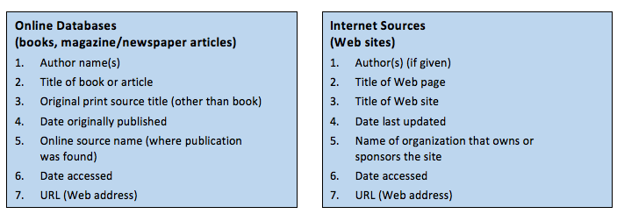
Citing Sources
Modern Language Association (MLA): most often used in the humanities, language, and literature (and is quite common in K-12 schools)
American Psychological Association (APA) often used in education and social sciences.

